Slide 1
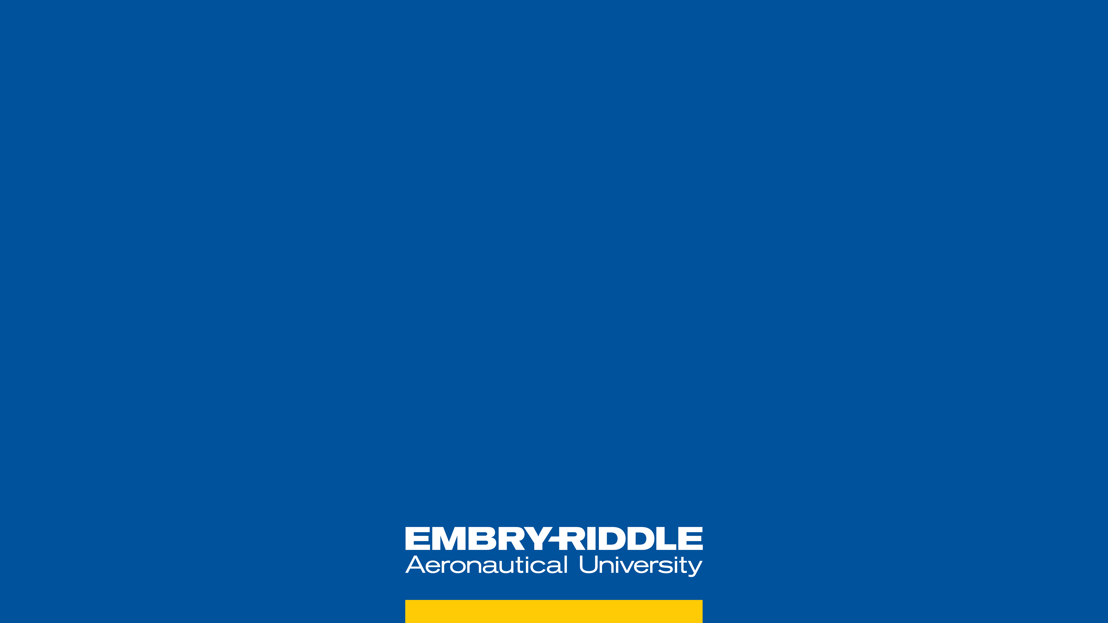


BIREFRINGENCE AND CURVATURE TESTING ON AlGaAs MIRRORS
PHYSICS / ENGINEERING
Ambroise Juston
Dr. Elizabeth Gretarson
Dr. Andri Gretarson

Slide 2
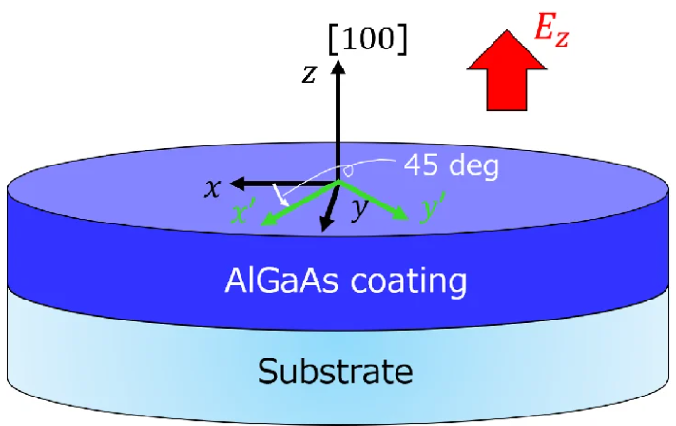
INTRODUCTION
Birefringence testing On AlGaAs Mirrors
Garrett D. Cole "Study on electro-optic noise in crystalline coatings toward future gravitational wave detectors"

Slide 3
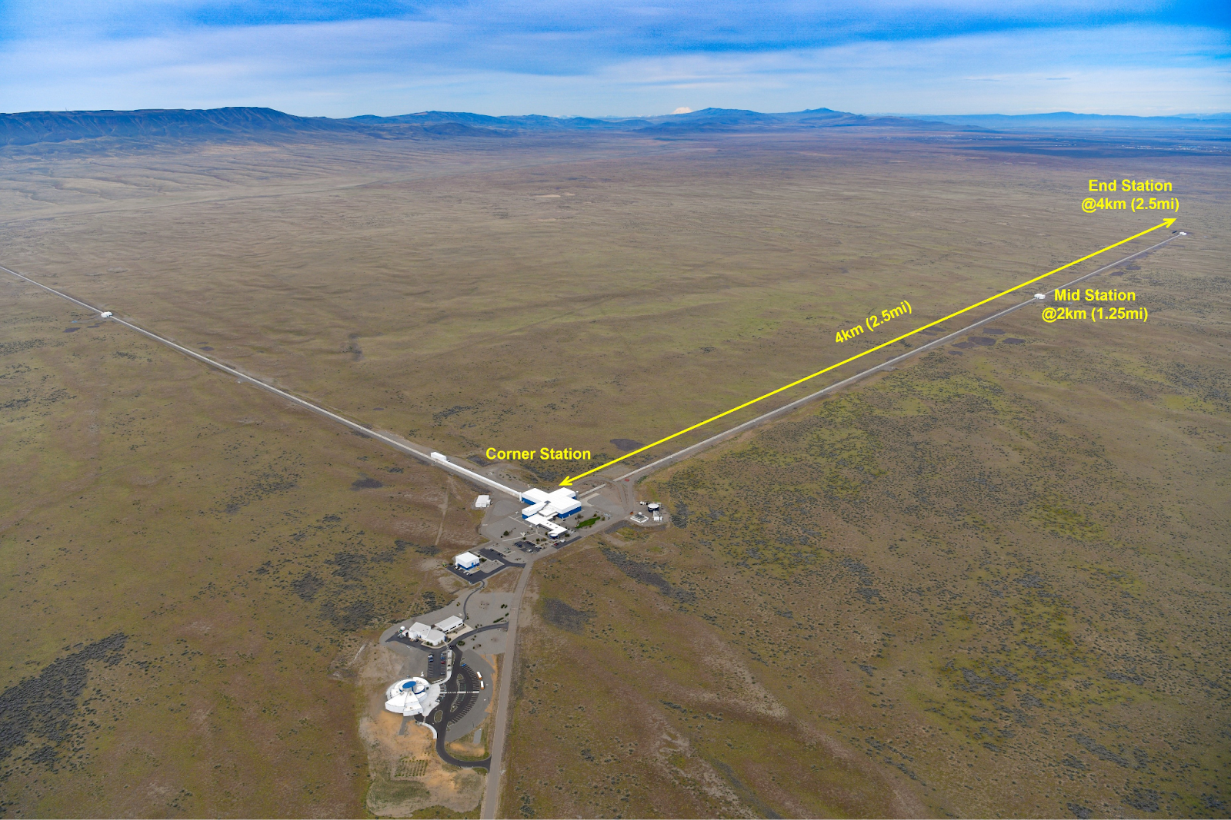
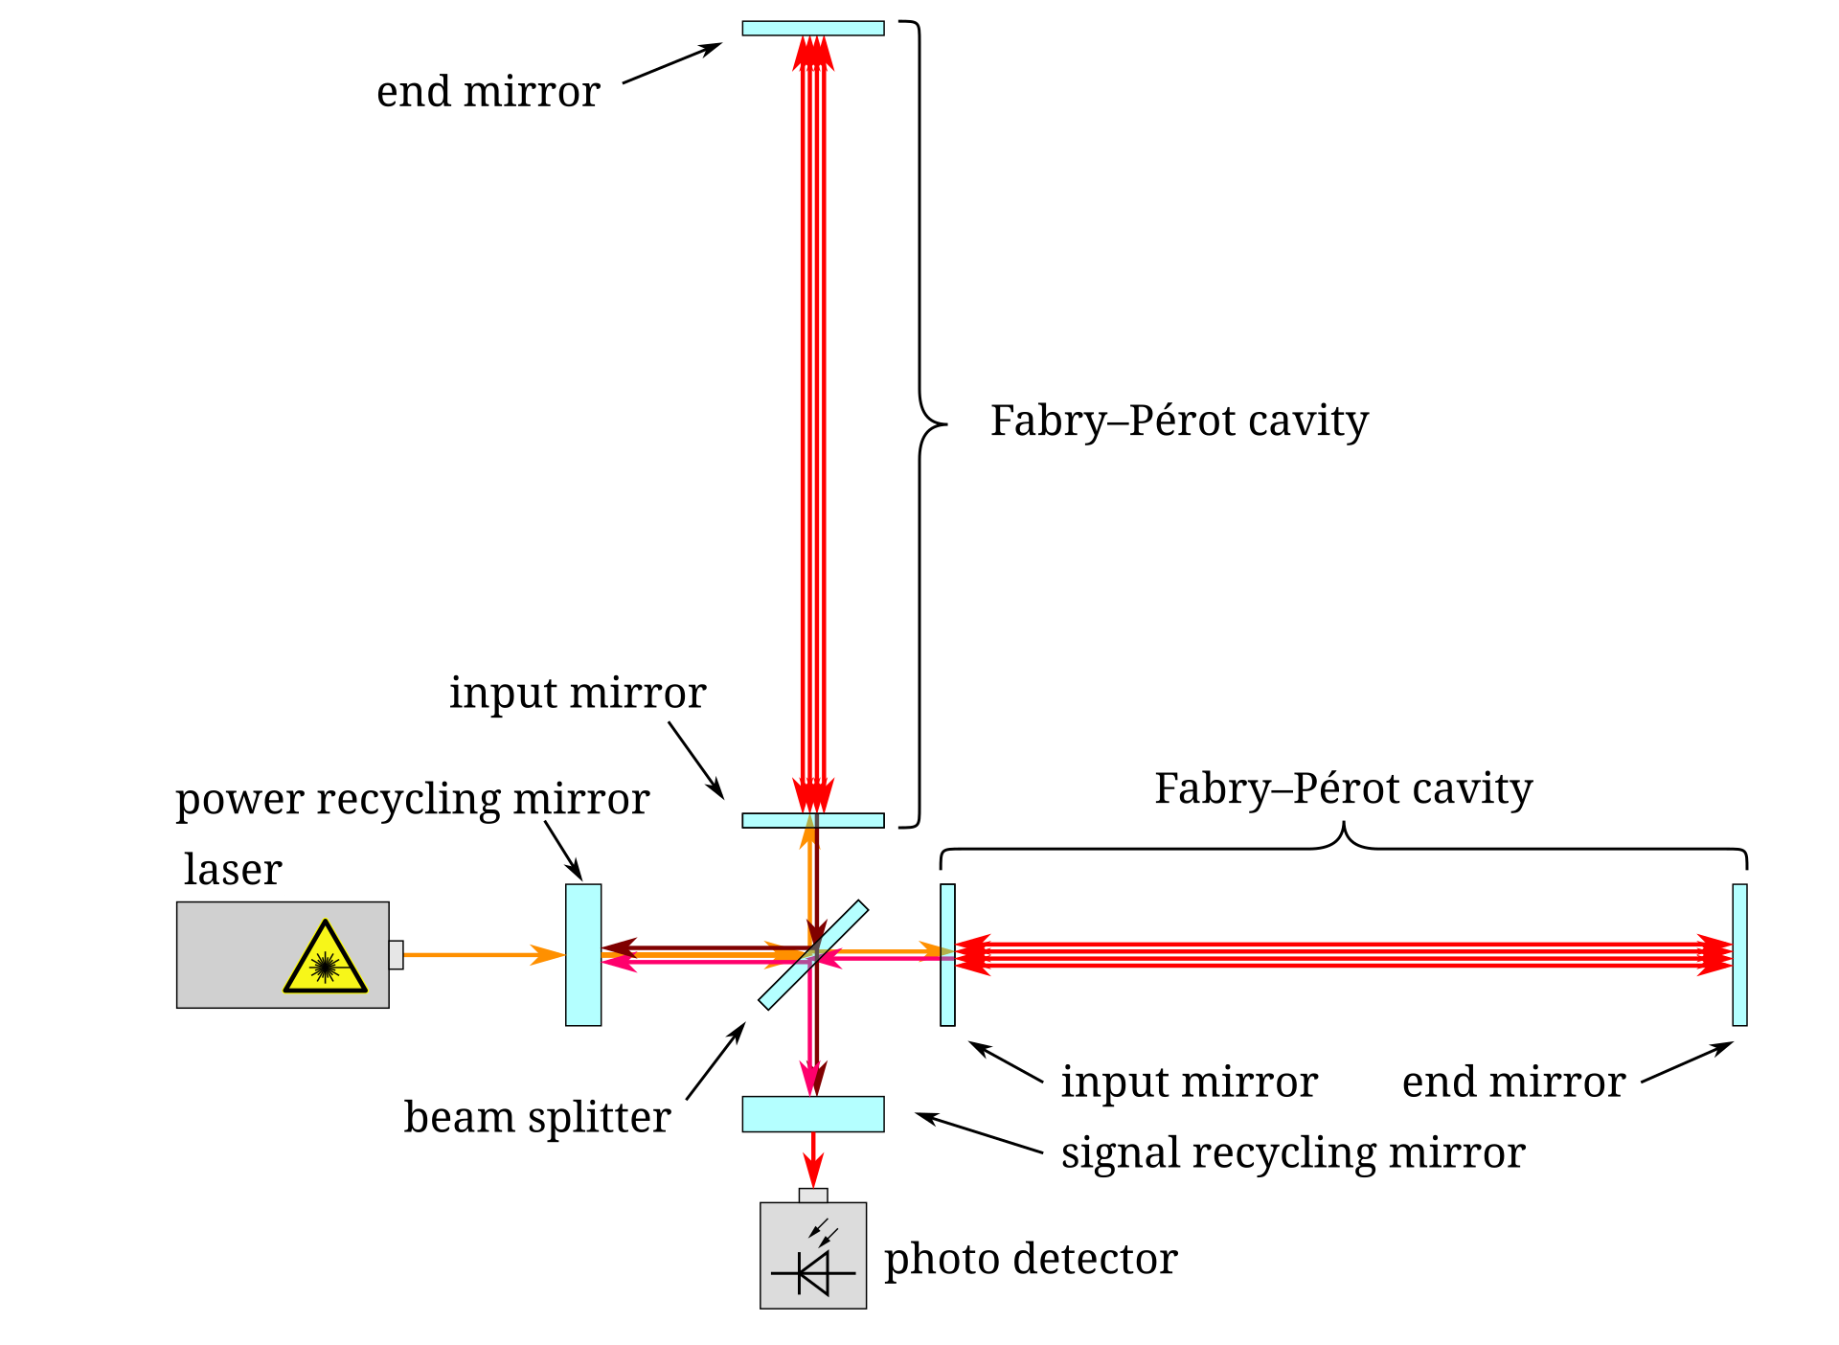
What is LIGO?
BACKGROUND
https://www.ligo.caltech.edu/page/ligo-detectors
https://simple.wikipedia.org/wiki/LIGO#/media/File:LIGO_simplified.svg

Slide 4
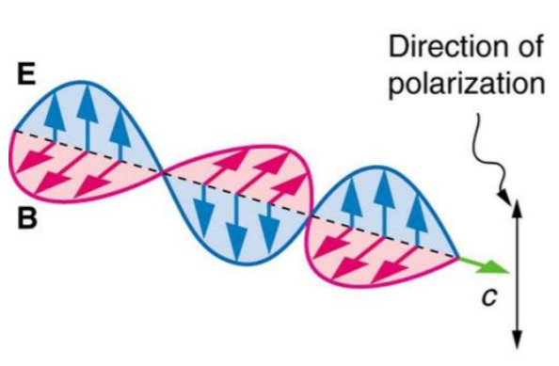
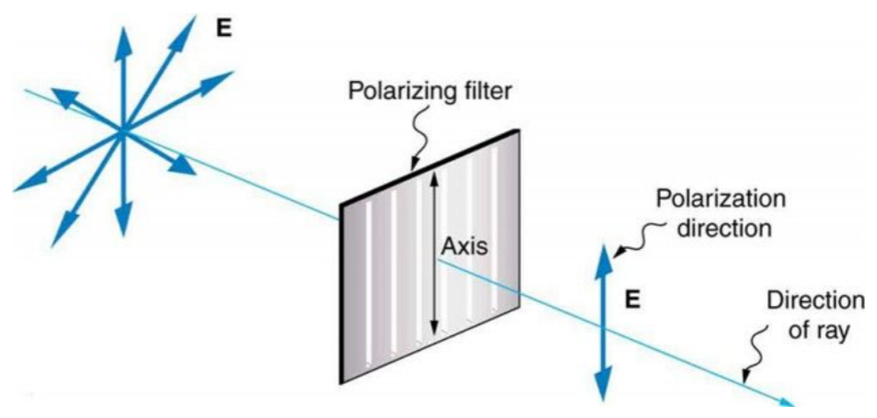
BACKGROUND
What is birefringence and why do we care?
https://www.collegesidekick.com/study-guides/physics/27-8-polarization

Slide 5

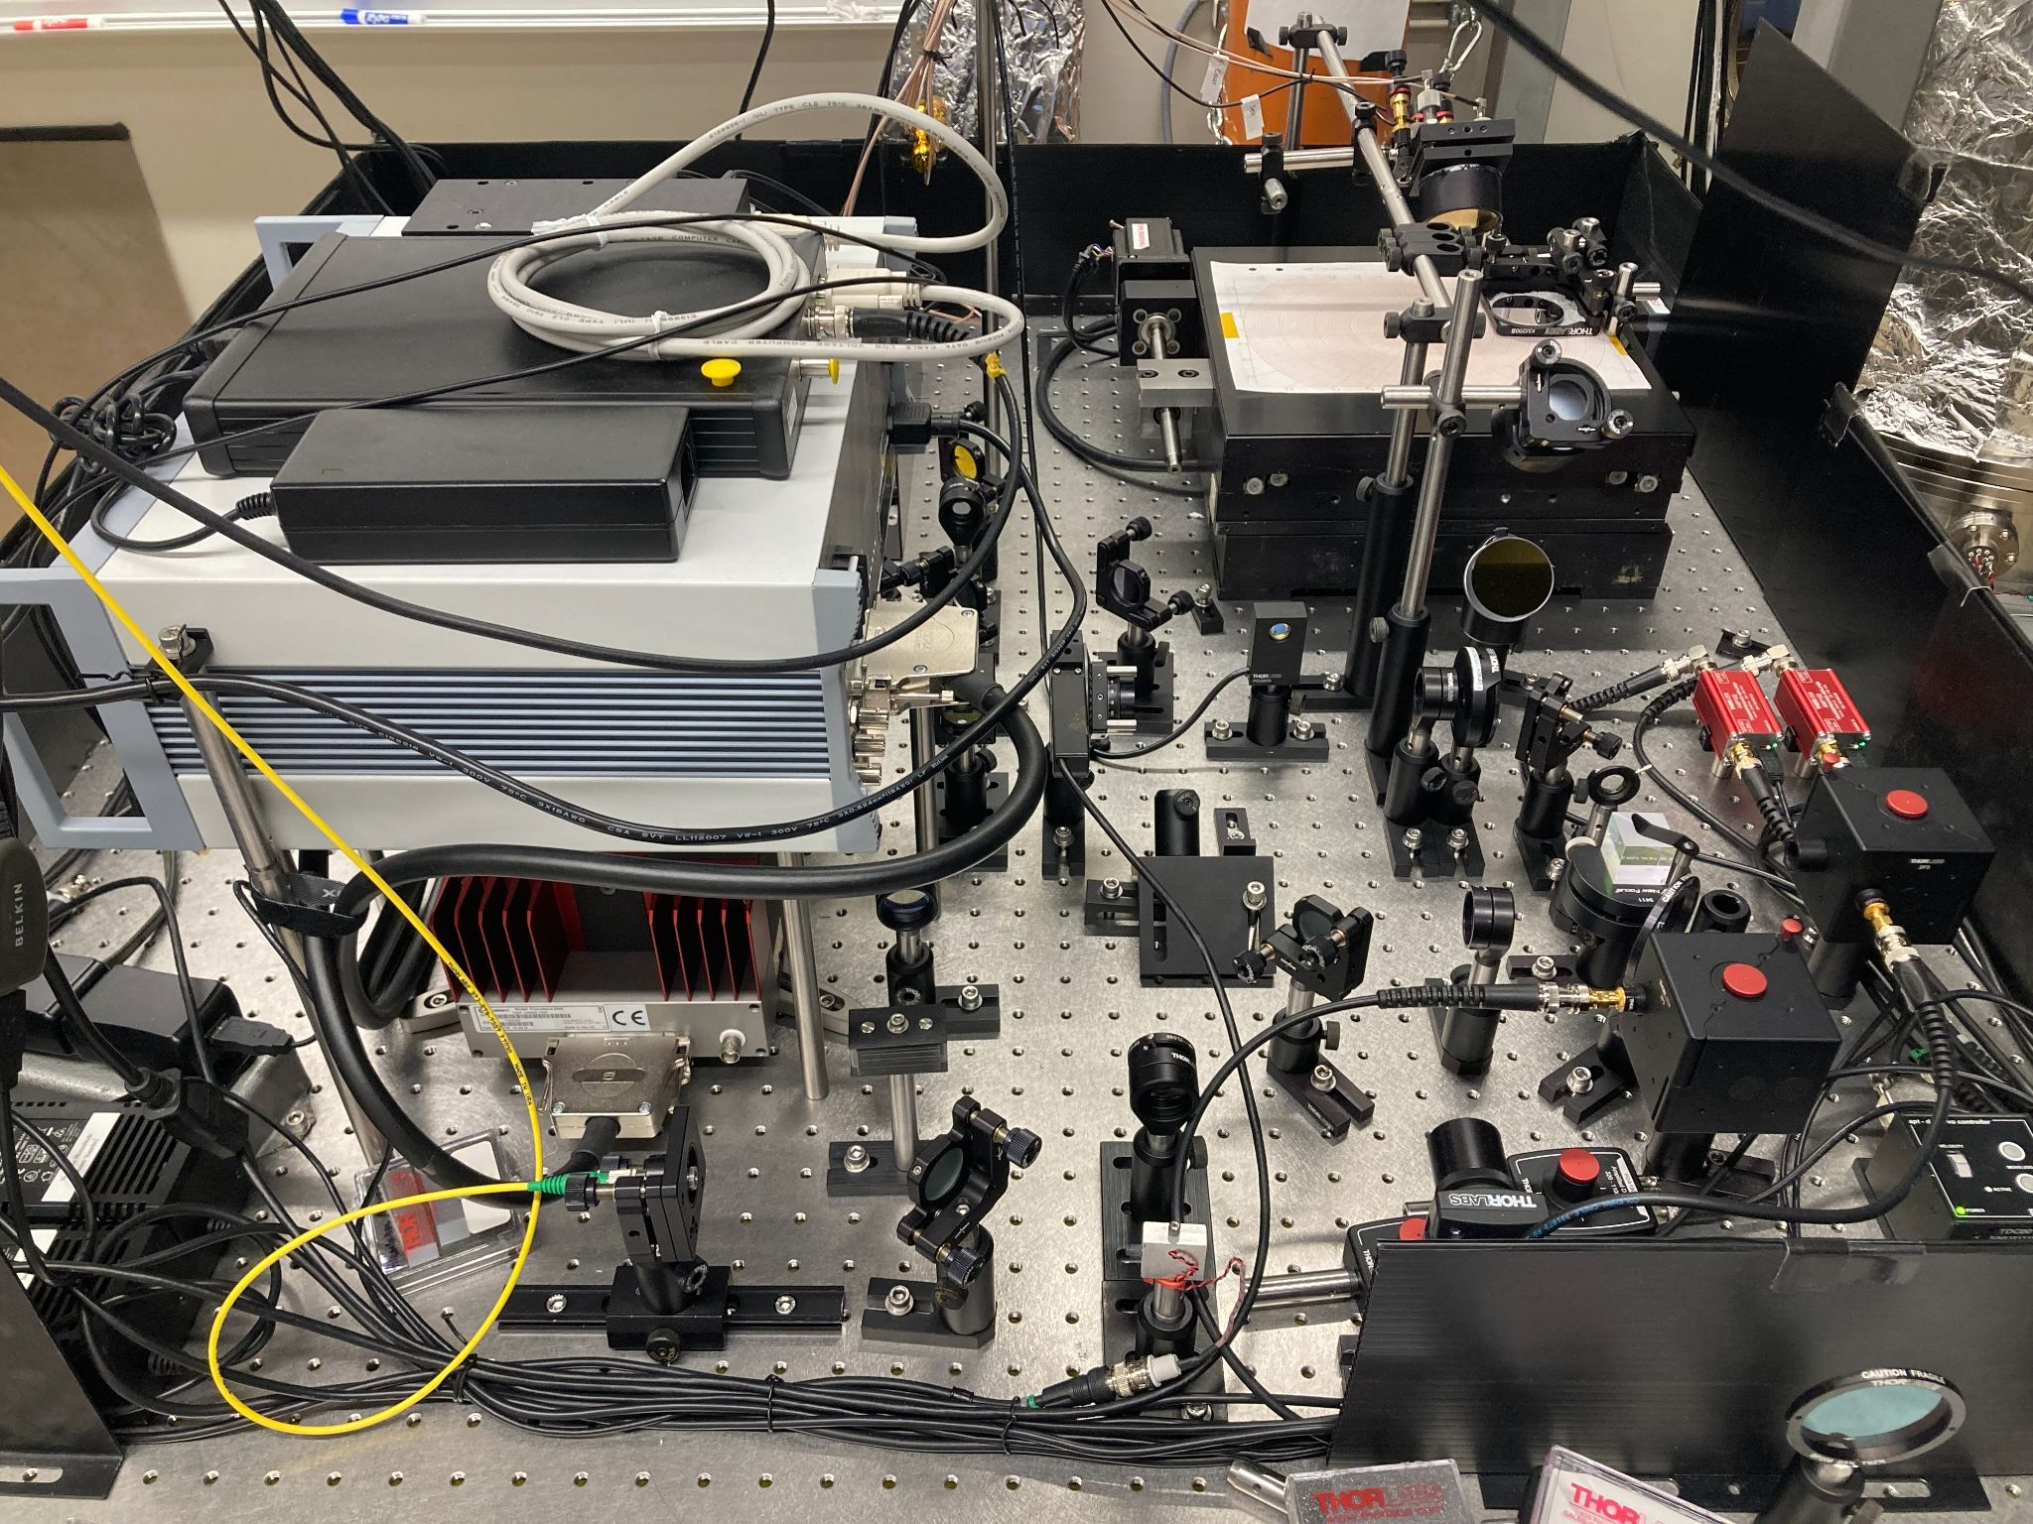
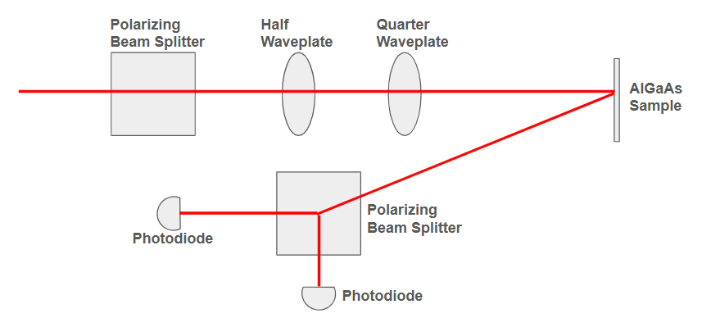
What are we doing?
PROJECT DESCRIPTION
Goal: Model and measure the curvature of AlGaAs mirrors and the birefringence of AlGaAs mirrors.

Slide 6
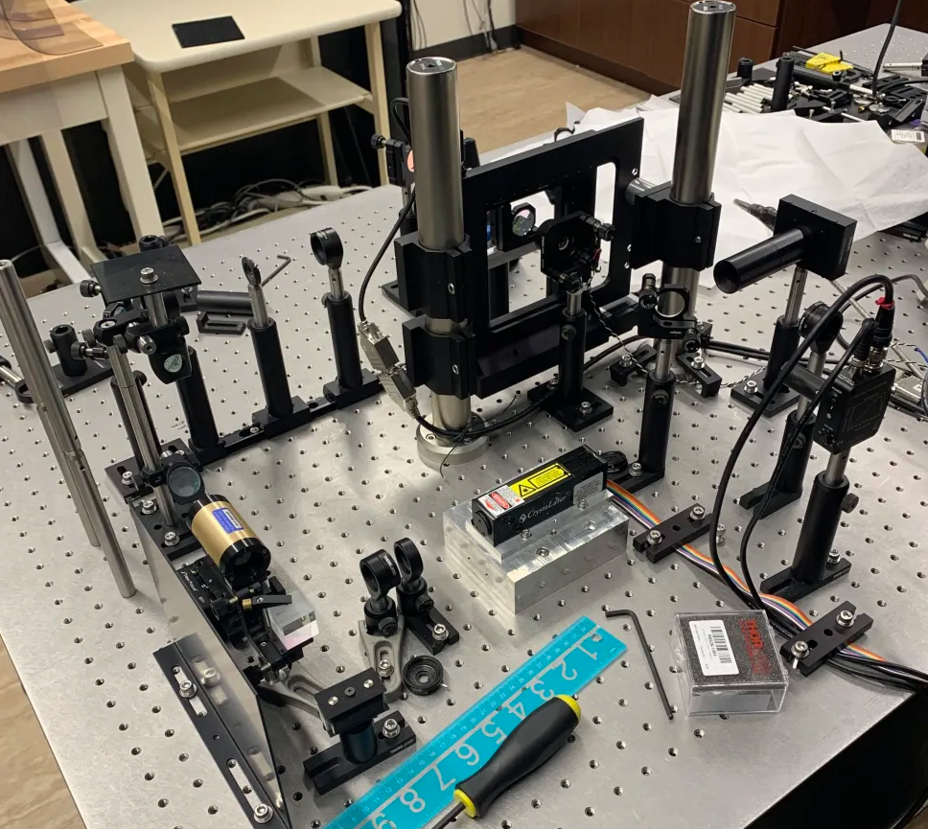
What else are we working on?
PROJECT DESCRIPTION
Goal: Develop and test new birefringence measurement techniques for high resolution mapping.

Slide 7
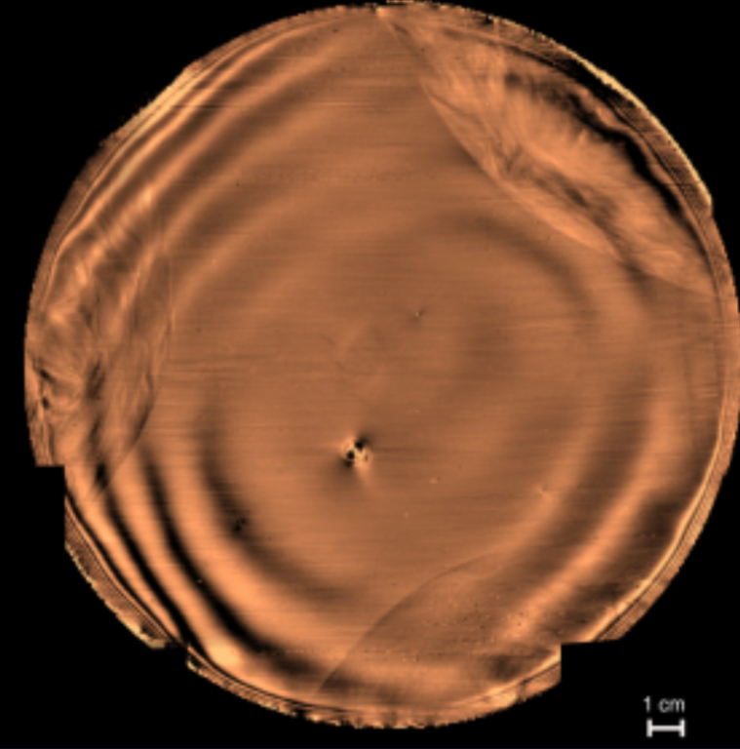
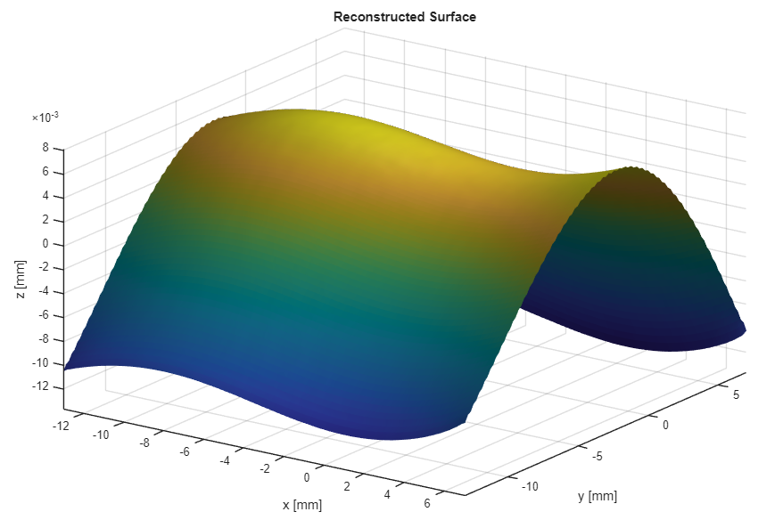
Results
PROGRESS
Localized Reconstructed Surface
Z
Y
X

Slide 8
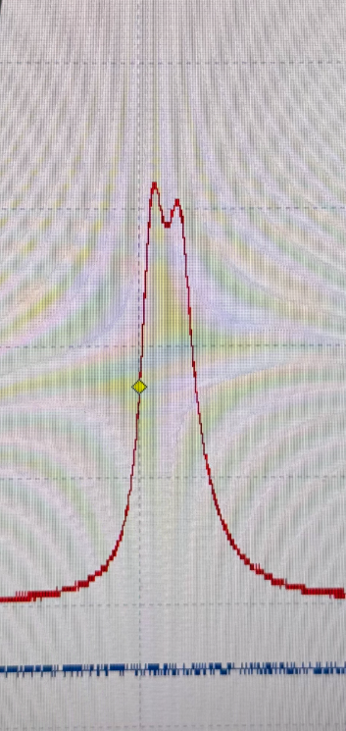
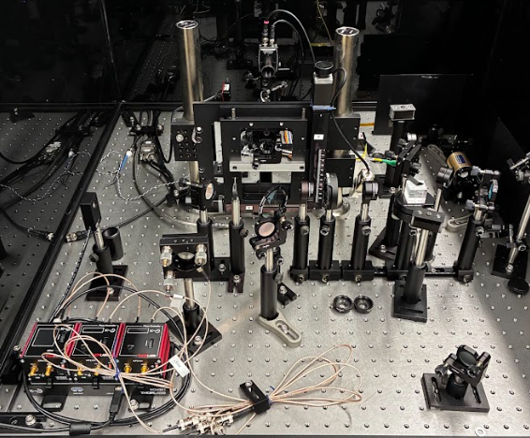
Results
PROGRESS

Slide 9
FUTURE PLANS

